Slide 1

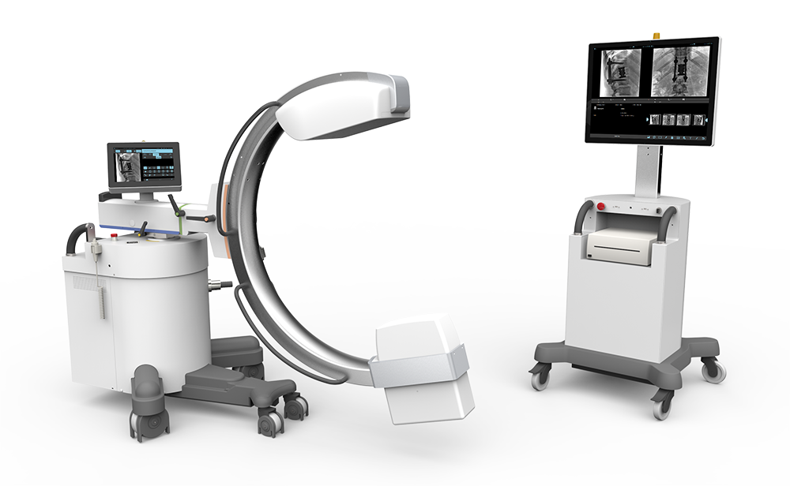


Slide 2
SUMMARY
CONFIGURATIONS
ERGONOMICS
WORKFLOW
CLINICAL APPLICATIONS

Slide 3
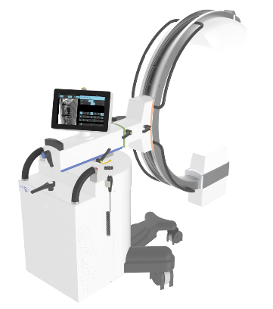

CONFIGURATIONS
Omniscop DReam
Generator 5 KW – Flat panel 21X21 cm
Generator 5 KW – Flat panel 30X30 cm
Generator 20 KW – Flat panel 21X21 cm
Generator 20 KW – Flat panel 30X30 cm

Slide 4
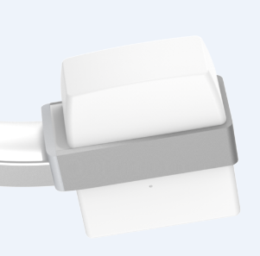
CONFIGURATIONS
Generator 5 KW
Monoblock
High frequency 40 kHz
Max voltage 120 kV
5 à 100 mA

Slide 5
CONFIGURATIONS
Generator 20 KW
Monoblock
High frequency 40 kHz
Max voltage 120 kV
12,5 à 150 mA

Slide 6
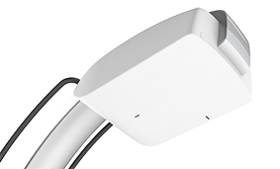
CONFIGURATIONS
Flat panel 21X21
TRIXELL Pixium 2121S
154µm
25 fps
Scintillator Iodide of cesium
DQE : 65% - 0,5 lp/mm
MTF : 80% - 0,5 lp/mm
Matrix 1334 x 1334 pixels

Slide 7
CONFIGURATIONS
Flat panel 30X30
TRIXELL Pixium 3030S
154µm
25 fps
Scintillator Iodide of cesium
DQE : 65% - 0,5 lp/mm
MTF : 80% - 0,5 lp/mm
Matrix 1954 x 1954 pixels

Slide 8
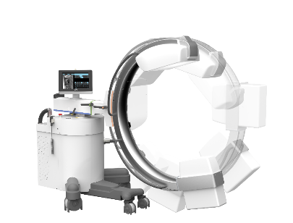
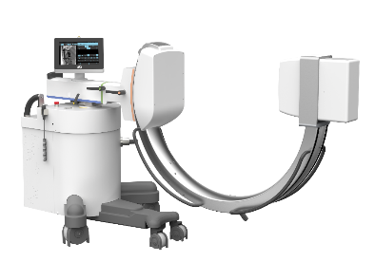
ERGONOMICS
C-arm
Depth : 71 cm
SID : 107 cm
Orbital rotation
95°/+65°
Horizontal rotation
+/-200°

Slide 9
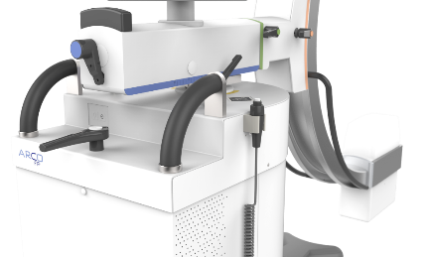
ERGONOMICS
Variable height motorised
+/-45 cm
Swivel
+/-12°

Slide 10
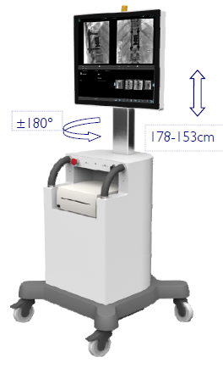
ERGONOMICS
Visualisation console
Screens rotation +/-180°
Variable height 153 to 178 cm
2 Full screens HD 22 ’’

Slide 11
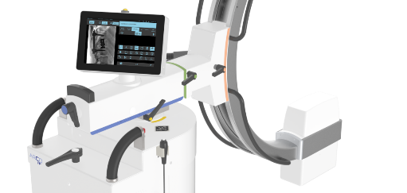
ERGONOMICS
Operator screens
Touch interface 12’’
Access to protocols and acquisition parameters
Real-time image display

Slide 12
ERGONOMICS
Dose management
Removable anti-scattered grid
Virtual collimation

Slide 13
WORKFLOW
Customizable protocols
Continuous Fluoroscopy / Pulsed / Snapshot
Frame rates : 1 to 25 images/s
Acquisition parameters customizable by protocol (KV, mAs, collimation, Zoom, ...)

Slide 14
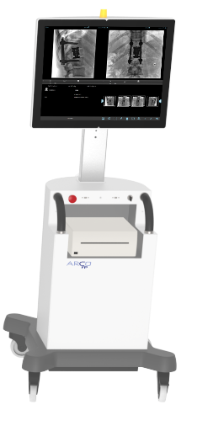
WORKFLOW
Visualisation console
22’’ Full HD screens
2 touch screens (« Reference » image and « live » image)
Storage around 135 000 images

Slide 15
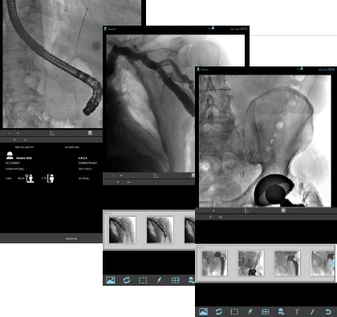
WORKFLOW
User interface
Customizable protocols
Advanced Post-processing (Recursives et spatials filters)
Annotations (liste and free)
Mesureaments and advanced tools (calculation of stenosis )

Slide 16
WORKFLOW
Dicom 3.0 options
Worklist
Store
Print
Query/Retrieve
Media export (USB)
Storage commitment
RDSR (structured dose report)
MPPS

Slide 17
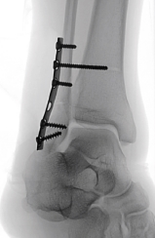
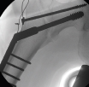
CLINICAL APPLICATIONS
Orthopedics
Hip
Extremities
….

Slide 18
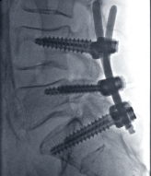
CLINICAL APPLICATIONS
Neurosurgery
Skull
Spine

Slide 19
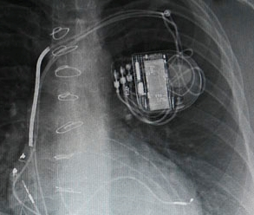
CLINICAL APPLICATIONS
Thorax /Abdomen
Pacemaker
Cholangiography
…

Slide 20
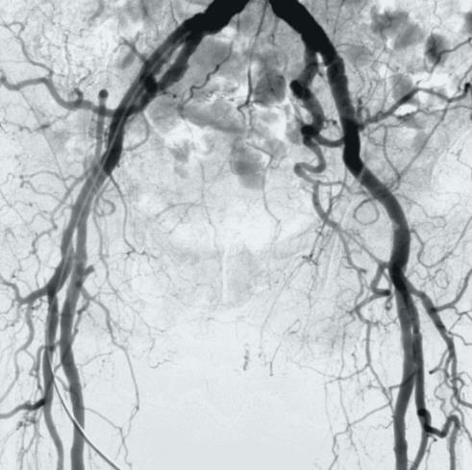
CLINICAL APPLICATIONS
Peripheral vascular
Abdominal vascular

Slide 21
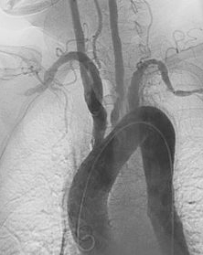
CLINICAL APPLICATIONS
Cerebrovascular
Carotids
Aneurism control
Cardiac
Angioplasty
Picc line (pose of chamber for chemotherapy)

